Slide 1
Water Quality Data Exploration with Lag
Alex Berk
From ABERK_wq_data_exploration.Rmd
Last Updated 8/27/25

Slide 2
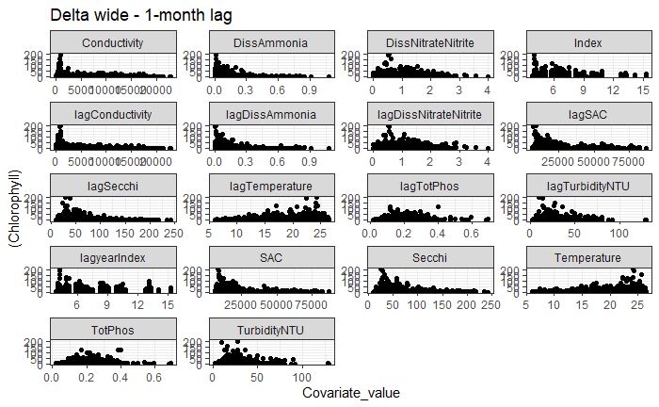

Slide 3
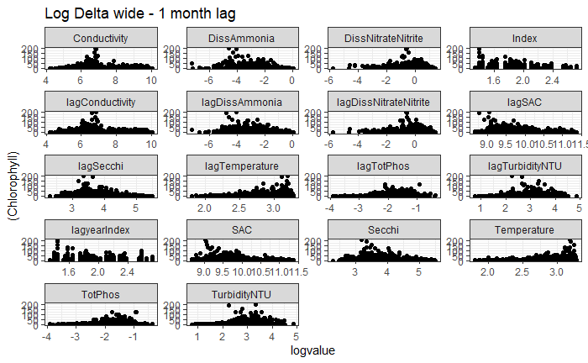

Slide 4


Slide 5
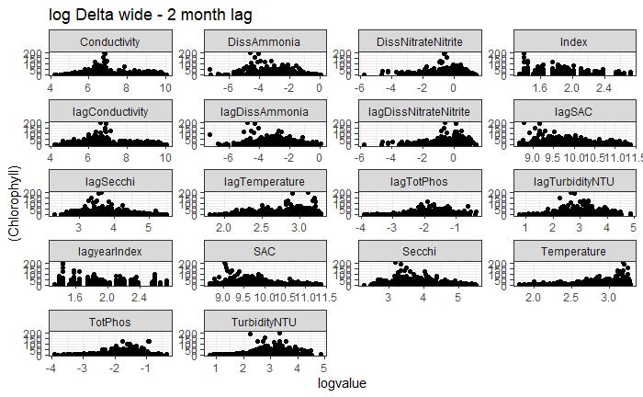

Slide 6


Slide 7
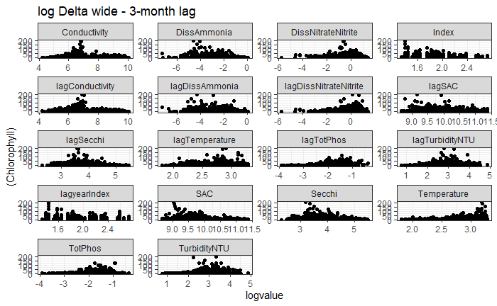

Slide 8
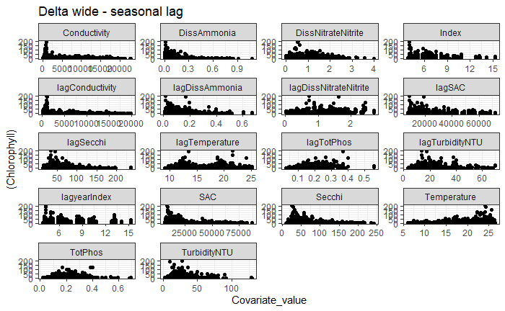

Slide 9
